Slide 1
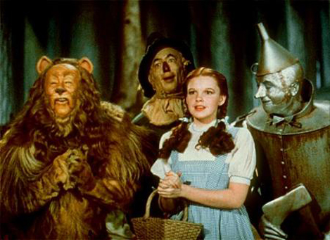
SubSonic, Subversion and On time Oh My!

Slide 2
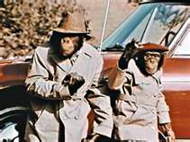
Today’s agenda
Need to know for code review
What is LINQ? Why use it?
What is SubSonic? How to use it today
Using Subversion to get latest of SubSonic
How to use ontimenow to document your application
Notes:
What is the project about?
Define the goal of this project
Is it similar to projects in the past or is it a new effort?
Define the scope of this project
Is it an independent project or is it related to other projects?
* Note that this slide is not necessary for weekly status meetings

Slide 3

Life Before LINQ
Write out connection code, pick a data object, iterate
Why this stinks…
Redundant
Different objects have different methods
No good intelligence for data results without effort
Notes:
* If any of these issues caused a schedule delay or need to be discussed further, include details in next slide.

Slide 4
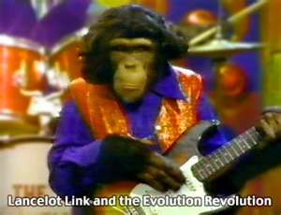
LINQ
Functional Language
Dyslexic SQL
Select columns from rows where column=value
from variable in tablename where tablename.column==“value" select variable.*
Examples in LINQPad
A simple query expression
LINQ works on objects
Notes:
Duplicate this slide as necessary if there is more than one issue.
This and related slides can be moved to the appendix or hidden if necessary.

Slide 5
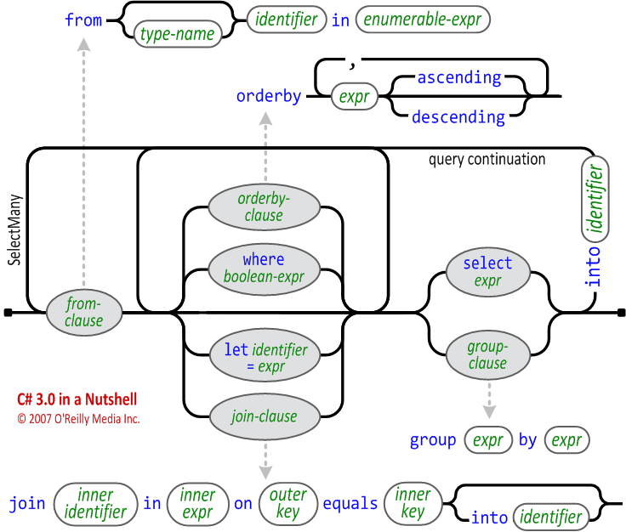
http://www.albahari.com/nutshell/linqsyntax.aspx

Slide 6
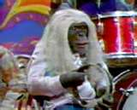
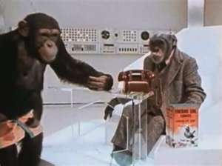
LINQ Examples-Multiple Statements
Selecting more than one value
Like vs. Contains
Lots of string functions available
Keep data pure→use logic to get correct presentation
Collections mean count
Group
Into
Notes:
Duplicate this slide as necessary if there is more than one issue.
This and related slides can be moved to the appendix or hidden if necessary.

Slide 7
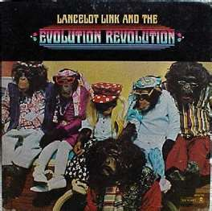
LINQ Examples-LINQ to SQL
Making a LINQ File in VS
Good news
Easy to create
Strongly typed object
Bad news
To cast to type need to set up at design time
If need to change need to remove all references!
So don’t…
Notes:
Duplicate this slide as necessary if there is more than one issue.
This and related slides can be moved to the appendix or hidden if necessary.

Slide 8
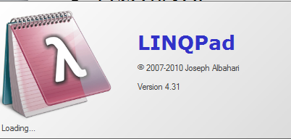
LINQPAD Examples
Looking at the other LINQPad Examples
LINQ to SQL
Note can run SQL from LINQPAD
Joins are for wimps → use your relationships to find objects
SU Universe example
Notes:
Duplicate this slide as necessary if there is more than one issue.
This and related slides can be moved to the appendix or hidden if necessary.

Slide 9
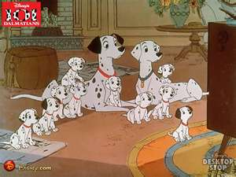
101 Examples
http://msdn.microsoft.com/en-us/vcsharp/aa336746.aspx

Slide 10
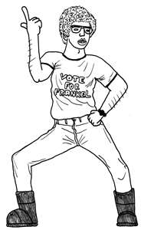
So what is this SubSonic thing?
Uses LINQ power
Automated generation of db objects
Can cast to Dataobjects or Strongly Typed
It works better than anything else at what it does

Slide 11

Ladder of Abstraction
.Net
LINQ
LINQ to SQL
SubSonic

Slide 12
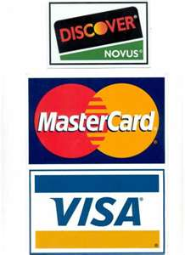
Giving Credit
http://subsonicproject.com/
Cool videos
Does a lot more than we are using it for
But what we use it for is getting data from DB
Best of its kind

Slide 13

It’s the Victoria Principal of it
Convention Over Configuration
Column names should never contain reserved words (system, string, int, etc)
Column names should not be the same as table names

Slide 14

The key to it
If you want to use SubSonic to access your table, you need to have a Primary Key defined for your table. This is good practice in every case and we need it to do certain things with your table. If you don't have a Primary Key defined, your class won't be generated.
If you call a column “ID” or “Key” or “[ClassName]ID” – no matter it’s type – that will be your Primary Key. If you have other things in mind you can use a primary key attribute [SubSonicPrimaryKey] contained in the SubSonic.SqlGeneration.Schema namespace and we’ll use that column.

Slide 15
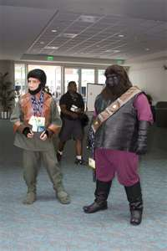
More conventions
Generated table names will be plural
Rails aesthetic
More at http://subsonicproject.com/docs/Conventions

Slide 16
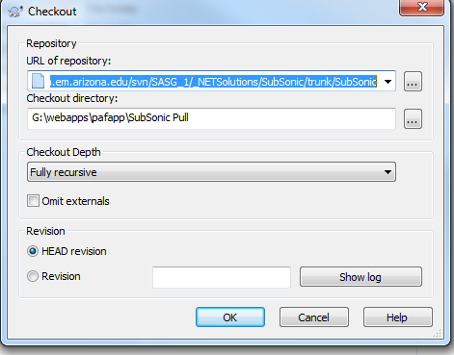
Look at the files
https://subversion.em.arizona.edu/svn/SASG_1/_NETSolutions/SubSonic/trunk/SubSonic
Pull latest build from Subversion
Create a new folder
Right Click->
SVNCheckout
Find folder
Click OK

Slide 17
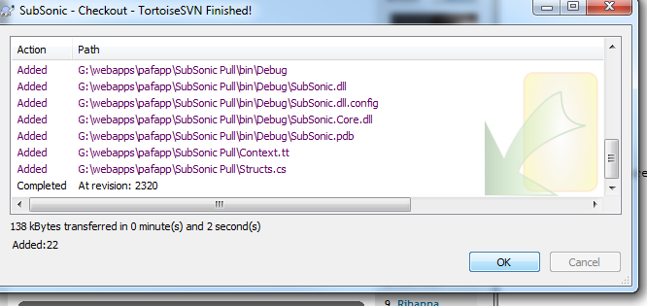
Tortoise wins by a hair

Slide 18
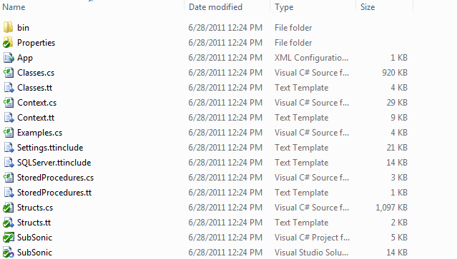
Green is good

Slide 19
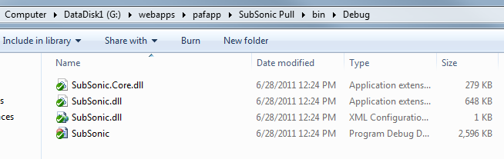
Dlls in the Howz

Slide 20

We need your help
Note-myself and Joe have made changes already to this project
You can too! Share the wealth.

Slide 21
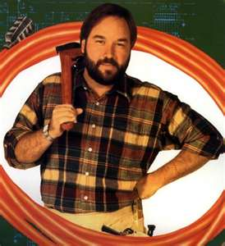
How do I use this?
Create a new class project and attach to your solution or…
Add a folder to your project

Slide 22
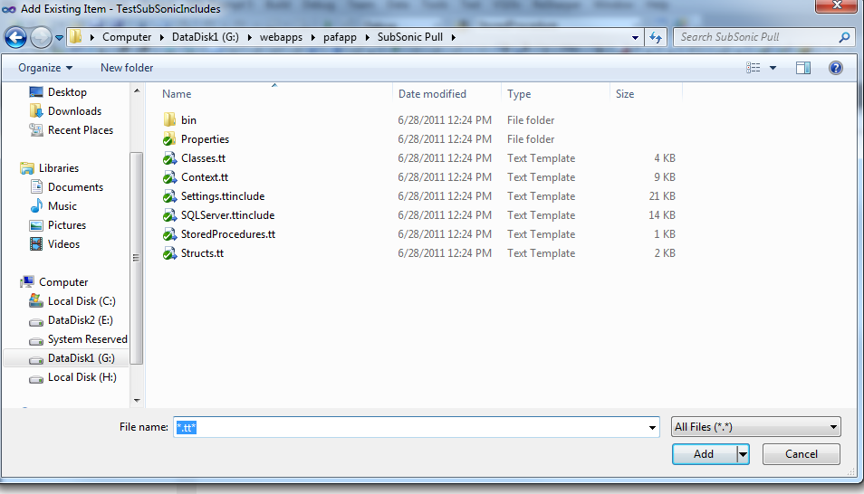
Put in tt files
Add existing
Pull all the tt and ttinclude files (All Files->*.tt*)

Slide 23
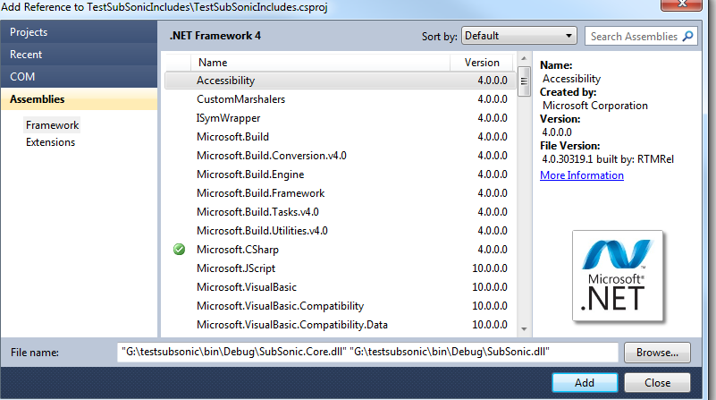
Add the dlls
Subsonic from the bin\debug folder and System.Data.LINQ

Slide 24
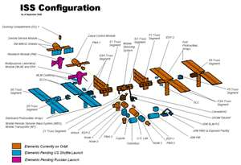
Add the config
If class project add an app.config
If using folder just use web.config
Add a connectionstrings section and a connectionstring

Slide 25

Configure the files-ttinclude
Settings.ttinclude
const string Namespace = "SubSonic.Data";
const string ConnectionStringName = “ConnectionstringName";
const string DatabaseName = “DatabaseName";

Slide 26
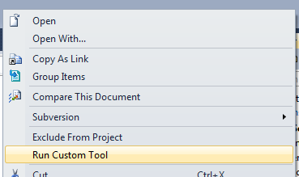
My Generation
Right click all tt files and click Run Custom Tool
Verify generation worked
Just include class as Data Layer if class project

Slide 27
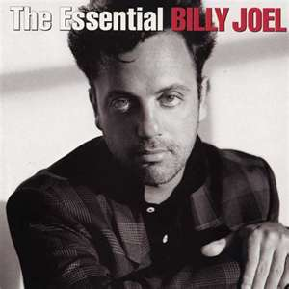
Please go changing ..
Add an sp or new table or view-just regenerate the code

Slide 28

Look at the examples code/Help Doc
Return dataset or datatable
Return strongly typed object
Return only one object
Datatable
Strongly Typed Object
Repository
See help document for more details

Slide 29
Repository Example From PS WebService
SubSonic.Data.OnlineApplicationDB db=new OnlineApplicationDB();
List<Country> countries = PSUpload.Country.GetCountries().ToList<PSUpload.Country>();
var stagerepository = new SubSonic.Repository.SubSonicRepository<PS_Country_STAGE>(db);
foreach (PSUpload.Country country in countries)
{
SubSonic.Data.PS_Country_STAGE stage = new PS_Country_STAGE();
stage.COUNTRY = country.country.ToString();
stage.COUNTRY_2CHAR = country.country_2char.ToString();
stage.DESCR = country.descr.ToString();
stagerepository.Add(stage);
}

Slide 30
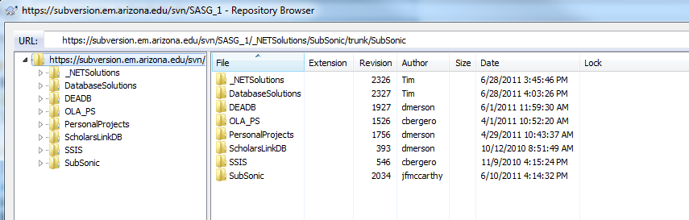
Subversion
Basic structure
Thoughts on other “sections”- Common Code maybe?

Slide 31
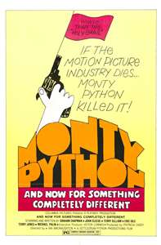
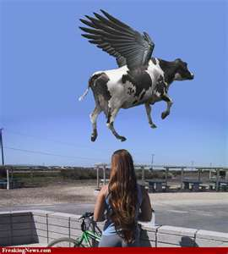
And now for something completely different
Let’s talk about rule 3

Slide 32
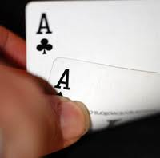
Theory of Poker
Imagine that you can see your opponent’s hand what would you do?
You would want the biggest payoff when you had the better hand
You would want small losses or none when you had the worse hand
So…
When the probability of winning is great, increase the pot
When the probability of losing is great, don’t increase the pot

Slide 33

Merson Theory of Development
All software are programmed reactions to events
User events
Background events
Therefore all programming items are in the following form:
If event X occurs then process Y should occur to change to state Z
Sometimes is X is multiple tasks but the postulate still holds
Examples
When I open the program(X), I expect to see Z triggered by process Y
When I click the report(X), show me Z triggered by process Y

Slide 34

The problem is…
There are a larger number of sequences that are possible for any application that you create than you can actually test
Note flexible apps are buggy-Excel has the many known bugs
Program design should be to maximize the independence of functionality
And since you can’t test ‘em all…

Slide 35

What me Test?
Only brush the teeth you want to keep
Only test the scenarios you want to work in production
Bug-I do x, I expected y but I got z
I clicked save expecting it to save and got a yellow screen of death
I looked at the report and there are only 3 records

Slide 36
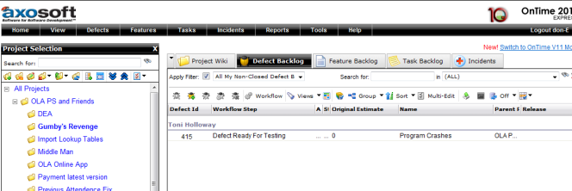
Ontimenow
https://emsg.ontimenow.com
Other failed systems
The email bug list
Sharepoint

Slide 37

Who is on already?
Top testing people-Toni and Tara
They already know how to use it
Me, Luis and Scholarship Universe people
You can be also

Slide 38
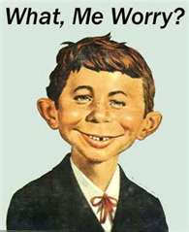
Why use it?
You can write in your features
Example of saved time-The dreaded close date debate
Customer signs off on features
You can have customer verify features
When there is a bug it is documented
Is a ticket not a loosely floating text statement
You have the customer verify the bug is fixed
The customer tells you when it is not fixed
You can better control the flow of items

Slide 39

In the end…
The customer has told you what they want
You have gotten confirmation from them that they got it

Slide 40
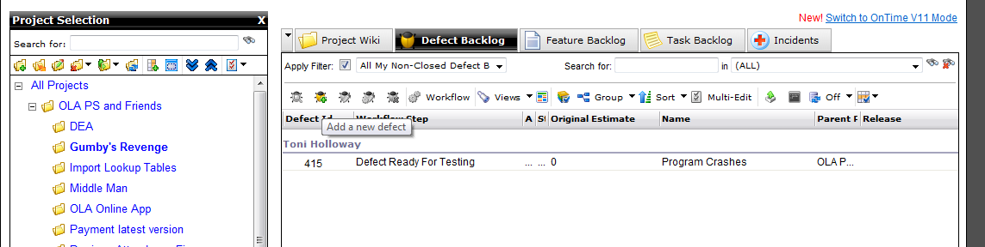
How to Use It-Quick And Dirty
Create a project
Can also create a sprint or release
SCRUM in 10 minutes video if interested on YouTube
Click on project-> Got To Features and click on Add
Ask me more about it offline

Slide 41
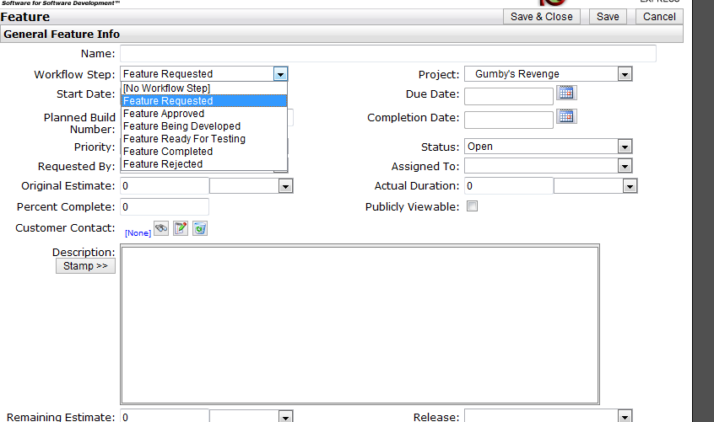
Quick and Dirty Feature

Slide 42
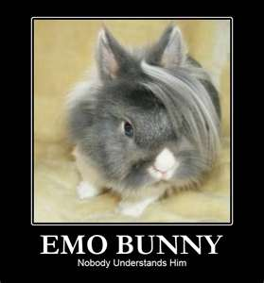
Features on the quick and dirty
Feature Requested-> Feature Ready For Testing
Feature Approved
If issue enter bug
Assign to a person
Use the description field and the time stamp feature only
This info will be sent via emails
When feature is complete->Status closed assigned to no one

Slide 43
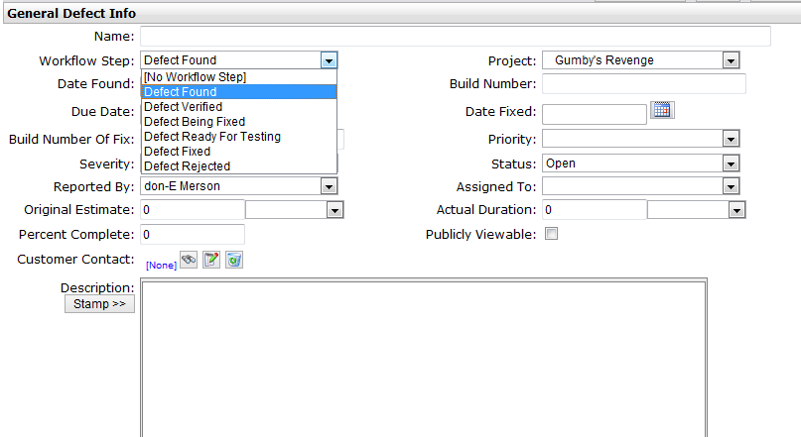
Bugs on the quick and dirty

Slide 44
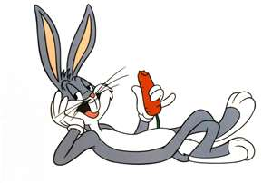
Bugs 101
Get users to understand a bug is the following:
I did x, I saw y and expected z
If you can’t duplicate it –reject the bug
Defect found-> Defect Approved->Defect Ready For Testing
Assign to developer or tester
Use description and timestamps also
When finished close status and make assigned to no one

Slide 45

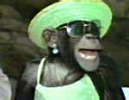
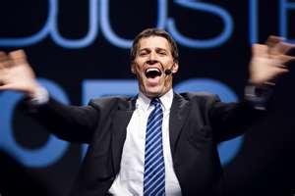
Ask me more …
I can get you started today
You will be happier
You will be better looking
People will like you better

Slide 46
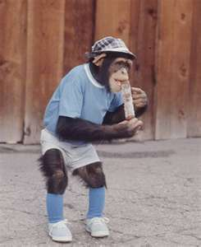
So to sum it up…
LINQ is good and powerful
SubSonic makes LINQ stronger
Pull SubSonic from Subversion to get latest version
Use Ontimenow for your projects to avoid headaches
Next week-Code Review

